Slide 1
Writing to text files
Mack 2022
Notes:
Last updated: 10-31-2022

Slide 2
Make a prediction
Starter activity
1 2 3 4 5 6 7 8 9 | file = open("quick.txt", "r") quicktext = file.readline() file.close() quicktext = file.readlines() print(quicktext)
Questions .
What will be the output of print, when this program is executed?
The first line from the text file will print
A list will be printed that contains each line from the text file as an item
The whole text will be printed with the first line repeated
An error will occur
1
2
3
▹
4

Slide 3
Make a prediction
Starter activity
1 2 3 4 5 6 7 8 9 | file = open("quick.txt", "r") quicktext = file.readline() file.close() quicktext = file.readlines() print(quicktext)
Why? .
Once the file has been closed it can no longer be read.

Slide 4
Make a prediction
Starter activity
1 2 3 4 5 6 7 8 9 | file = open("quick.txt", "r") quicktext = file.readline() file.close() quicktext = file.readlines() print(quicktext)
Why? .
Once the file has been closed it can no longer be read.
An error will occur when the program tries to access a closed file.

Slide 5
Make a prediction
Starter activity
1 2 3 4 5 6 7 8 9 | file = open("quick.txt", "r") quicktext = file.readline() file.close() quicktext = file.readlines() print(quicktext)
Question .
When should you close a file?
Answer .
When you have finished accessing/modifying it.

Slide 6
Make a prediction
Starter activity
1 2 3 4 5 6 7 8 9 | file = open("quick.txt", "r") quicktext = file.readline() file.close() quicktext = file.readlines() print(quicktext)
Question .
Why should you close a file when you are finished with it?
Answer .
Closing the file frees up system resources and protects the data.

Slide 7

Lesson 4: Writing to text files
Objectives
In this lesson, you will:
Write to text files
Append to text files

Slide 8
Writing to a new text file
Activity 1
file = open("players.txt","w")
There are four modes for opening a file:
r for only reading files
w for only writing to files
a for adding to an existing file
r+ for reading and writing files

Slide 9
Writing to a new text file
Activity 1
file = open("players.txt","w")
When you open a file in write mode, it creates a new file with the specified file name.

Slide 10

Writing to a new text file
Activity 1
file = open("players.txt","w")
When you open a file in write mode, it creates a new file with the specified file name.
If that file already exists, then the file will be overwritten.

Slide 11

Writing to a new text file
Activity 1
file = open("players.txt","w")
Live coding

Slide 12
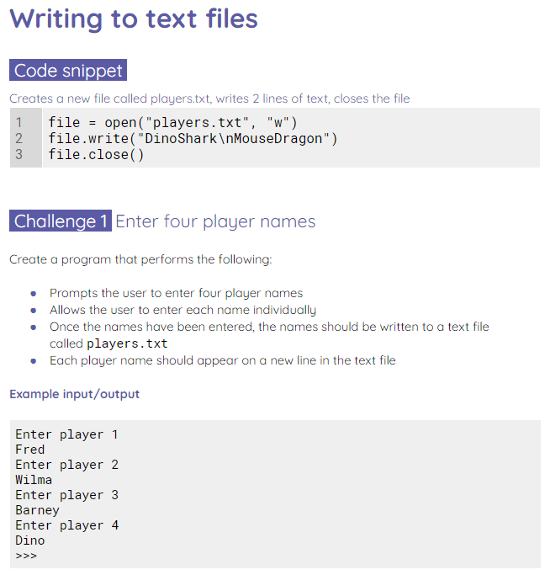
Writing to a new text file
Activity 1
Use the worksheet to try some mini challenges.

Slide 13
Appending to a text file
Activity 2
file = open("players.txt","a")
When you append to a file, you are adding new data to the end of the text file.
The mode character for appending to a file is an a.

Slide 14
Appending to a text file
Activity 2
file = open("players.txt","a")
file.write("DragonShark")
There is no append method for text files. The write() method is used to write and append files.

Slide 15
Appending to a text file
Activity 2
file = open("players.txt","a")
file.write("DragonShark")
Question .
What is missing from the program for it to work correctly?

Slide 16
Appending to a text file
Activity 2
file = open("players.txt","a")
file.write("DragonShark")
file.close()
Question .
What is missing from the program for it to work correctly?
Answer .
The file must be closed in order for the program to work as expected. The file will remain open and won’t be updated.

Slide 17
Appending to a text file
Activity 2
file = open("players.txt","a")
file.write("DragonShark")
file.close()
Live coding

Slide 18
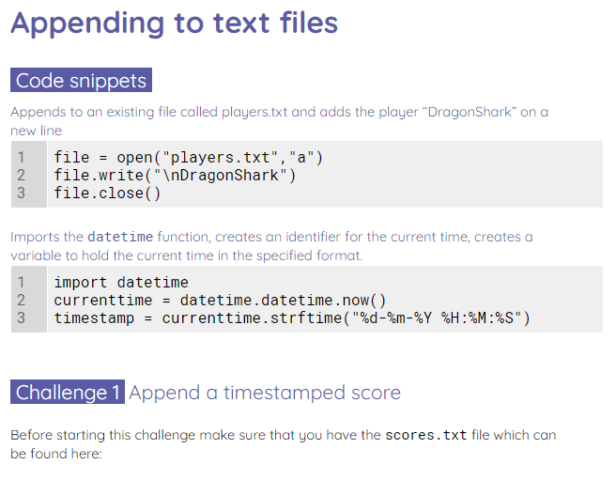
Appending to a text file
Activity 2
Use the worksheet to complete some append challenges.

Slide 19

Think of an example
Plenary
Using today’s challenges as a guide, what other programs would benefit from appending and writing to text files?
Notes:
Image source: https://pixabay.com/illustrations/lightbulb-bulb-light-idea-energy-1875247/

Slide 20
Next lesson
Summary
In this lesson, you…
Learnt how to append to text files
Next lesson, you will…
Read from a CSV file

